Slide 1
Activity-On-Arrow (AOA) Diagram
Example

Slide 2
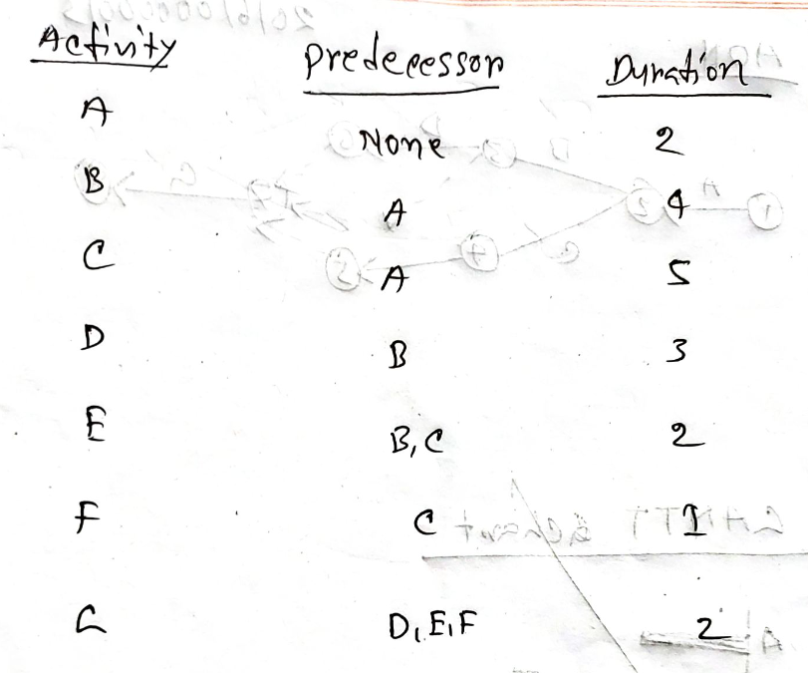
D
3
B
E
D
A
E
G
1
2
5
6
7
E
F
C
4
F

Slide 3
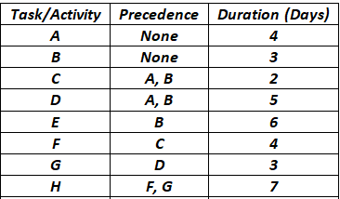
F
C
4
F
3
6
A
H
D
G
5
G
7
1
E
E
B
2

